Slide 1

CROWDFARM
A financial Support Network To Help Smallholder Farmers Build up the Capital They Need to Maximize Production

Slide 2
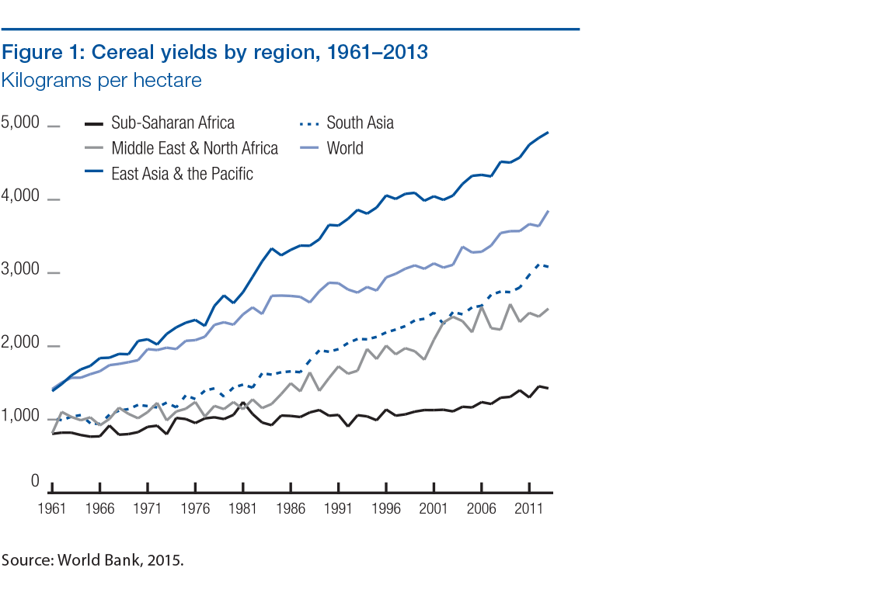
Problem
Farmers can’t afford the quality inputs required to produce food
This greatly reduces the yield they get
Notes:
inadequate funding for agricultural operations in Africa negatively affects the farming operations of smallholder farmers.

Slide 3

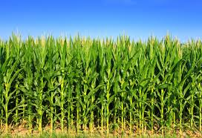

Solution
A financial support network that connects investors to smallholder farmers.
The smallholder farmer can now acquire the resources they need to maximize yield
Increased Productivity/
Quality Seeds/GAP

Slide 4
The Impact
Fixed cost (FC)
Machinery
Land
Revenue (R)
Profit (P)
= R - FC
Fixed cost (FC)
Variable costs (VC)
Fertilizers
Certified seeds
Pesticides
Revenue (R)
51% increase in production
Profit (P)
= R – (FC+VC)
Cost of production
Total returns from sale of produce
Net profits
Make agribusiness more attractive to young people
Notes:
SMS, USSD, our Android App and website

Slide 5
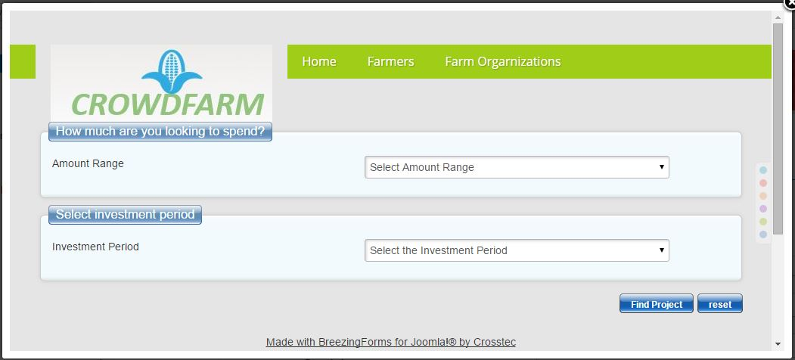
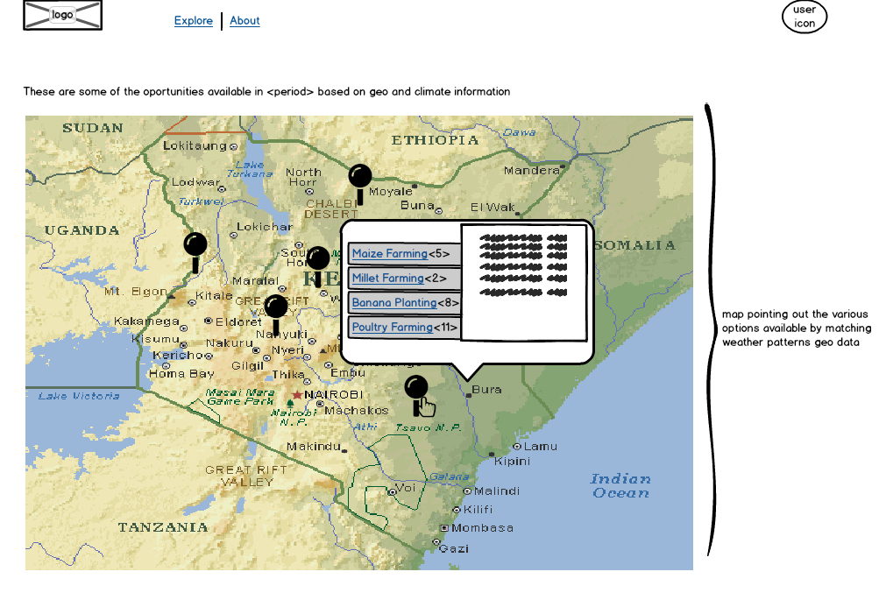
Demo

Slide 6

Business Model
Commission based on 5% to 10% of the profits

Slide 7
Target Market
Target Market
Farmers organizations/smallholder farmers/extension officers/NGOs
To reach our customers
Farmer orgarnizations/groups/website/Table banking initiatives
Growth strategy
Value Additions/processing/Membership/community/market linkage

Slide 8

Q &A

